Slide 1
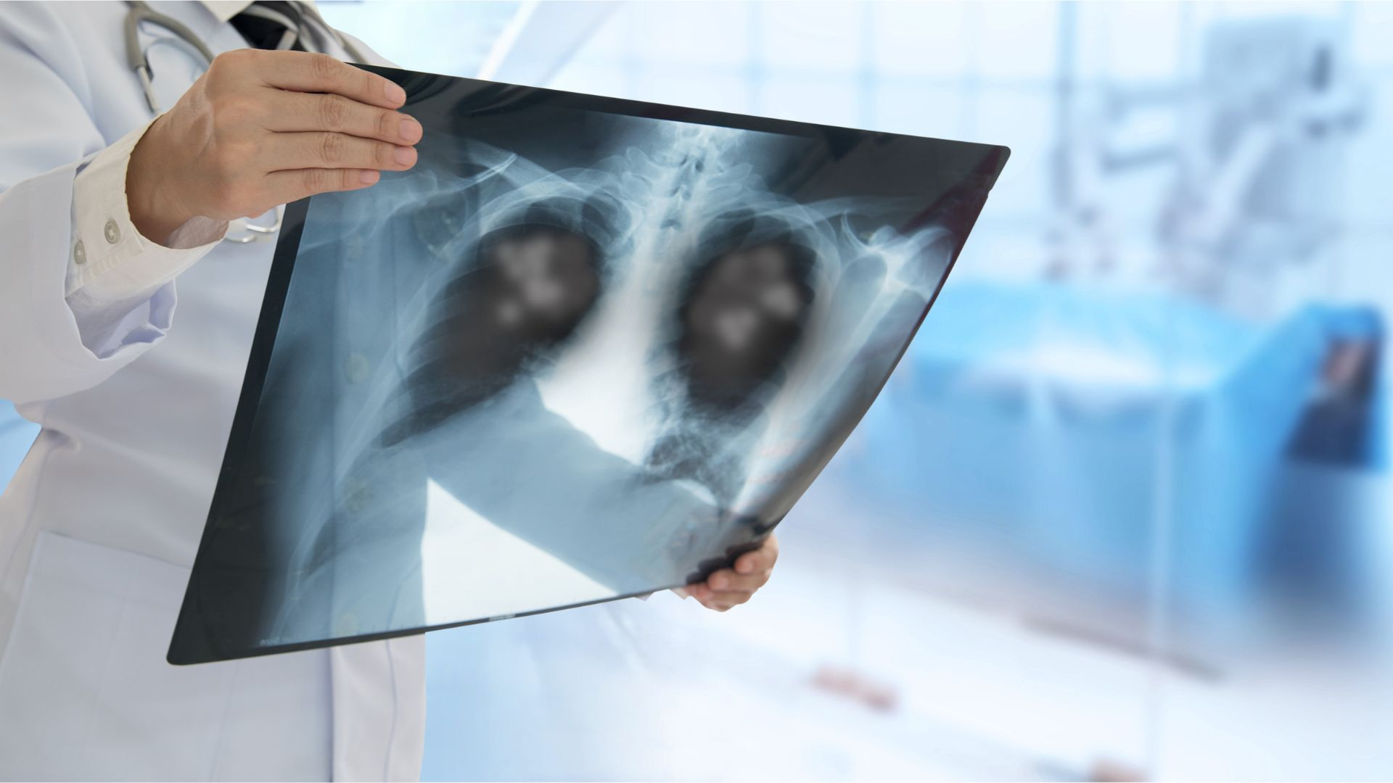
Pneumonia detection using chest x-ray
Rahul Sharma
Shubhangi Gupta
Sanchit Bhardwaj
Hema Bhavani
Aarti Dangi
Application of Computer Vision to create a Deep Learning model which can detect pneumonia from X-rays at an accuracy comparable to a practicing radiologist.

Slide 2
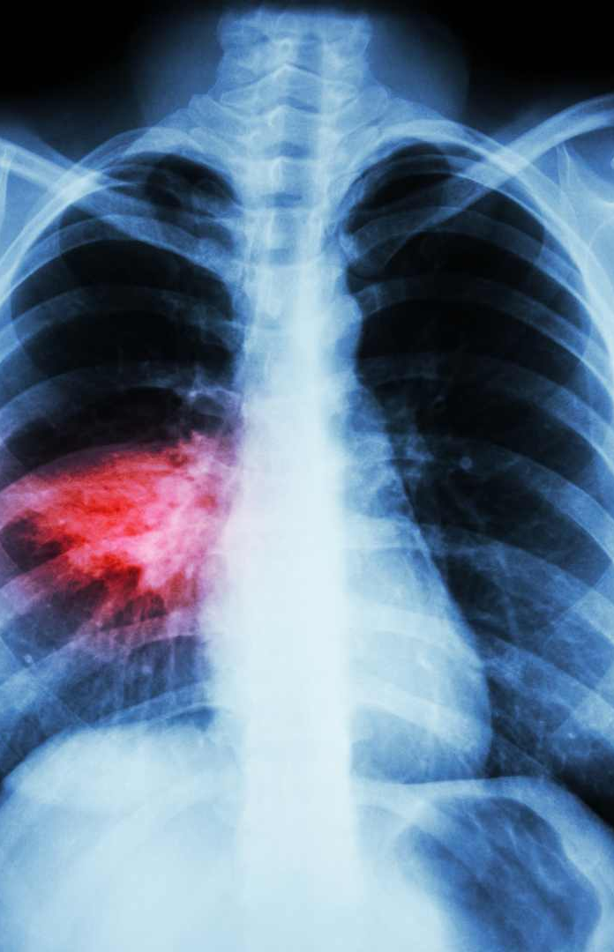
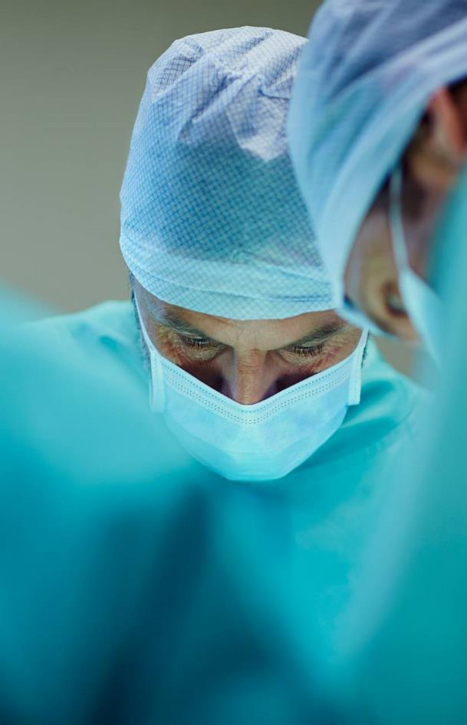
Capstone presentation
Research Motivation
Methodology
Model Architecture
Results
Conclusion

Slide 3
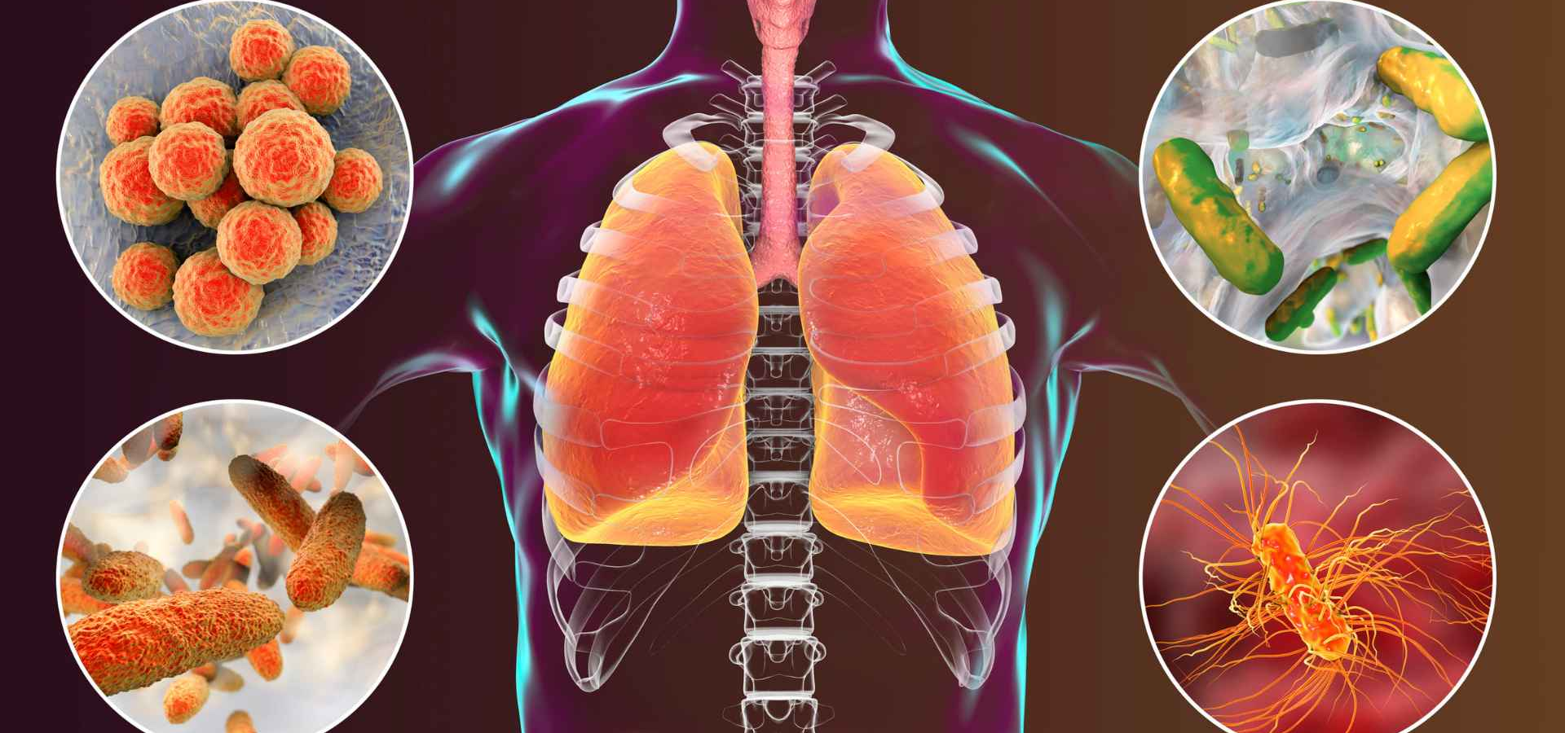
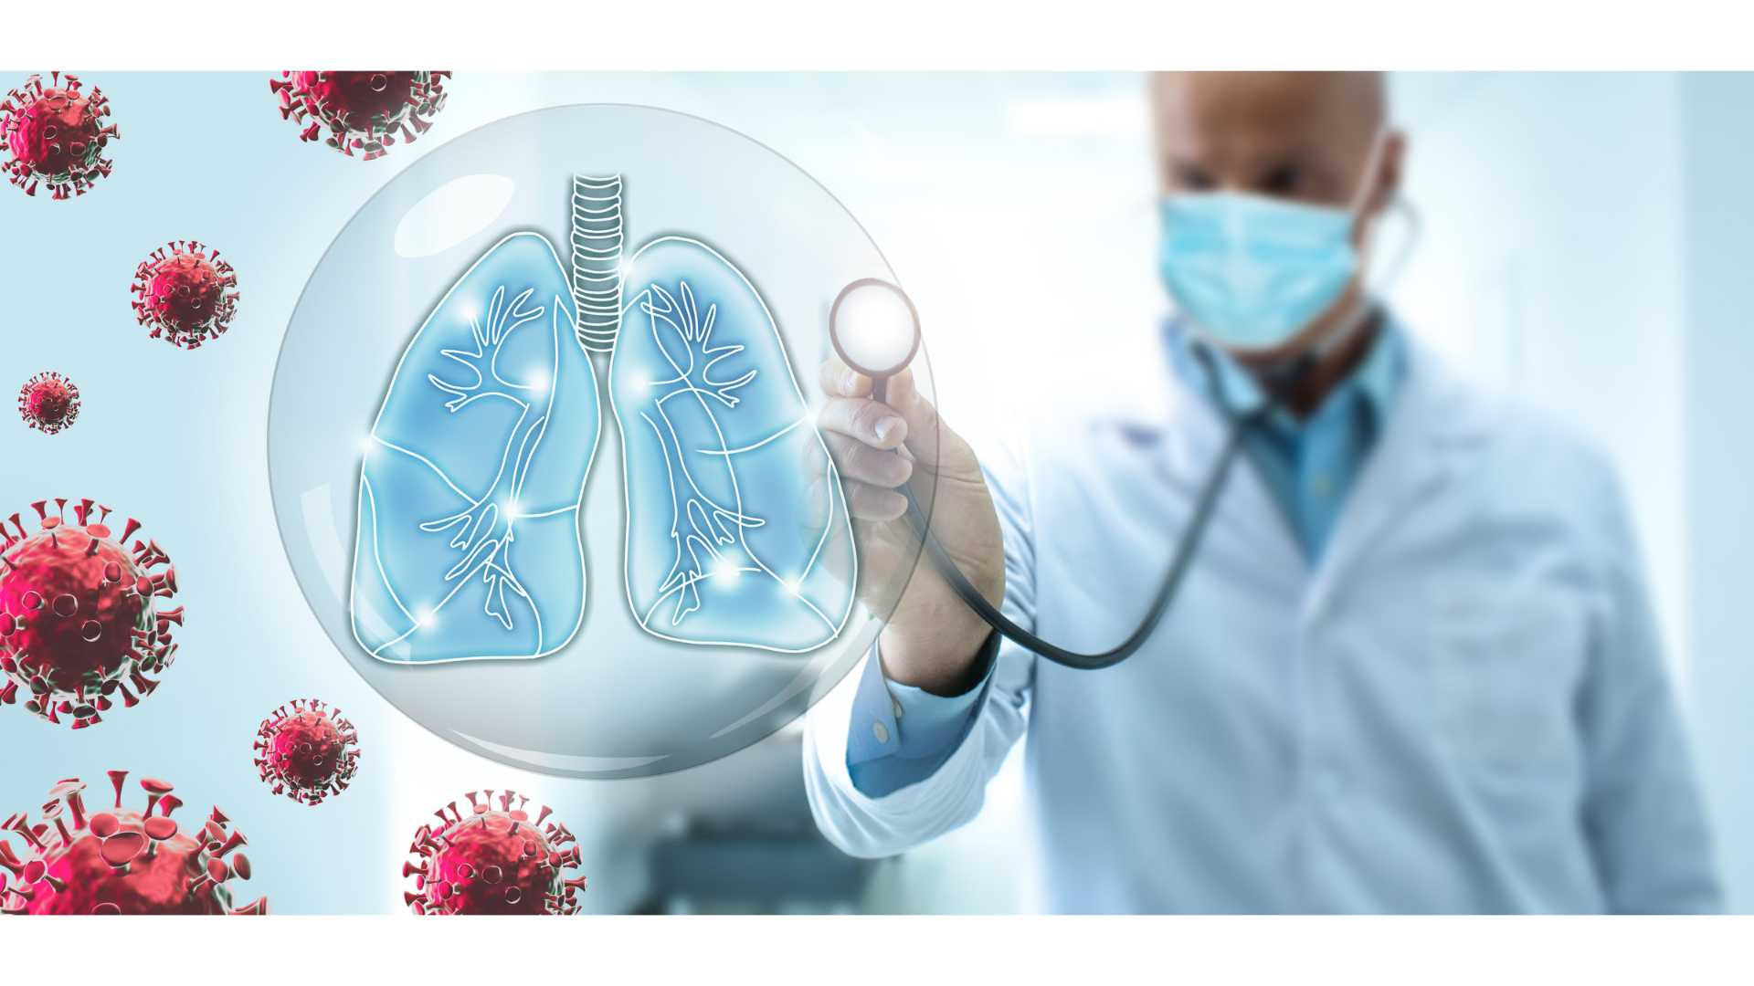
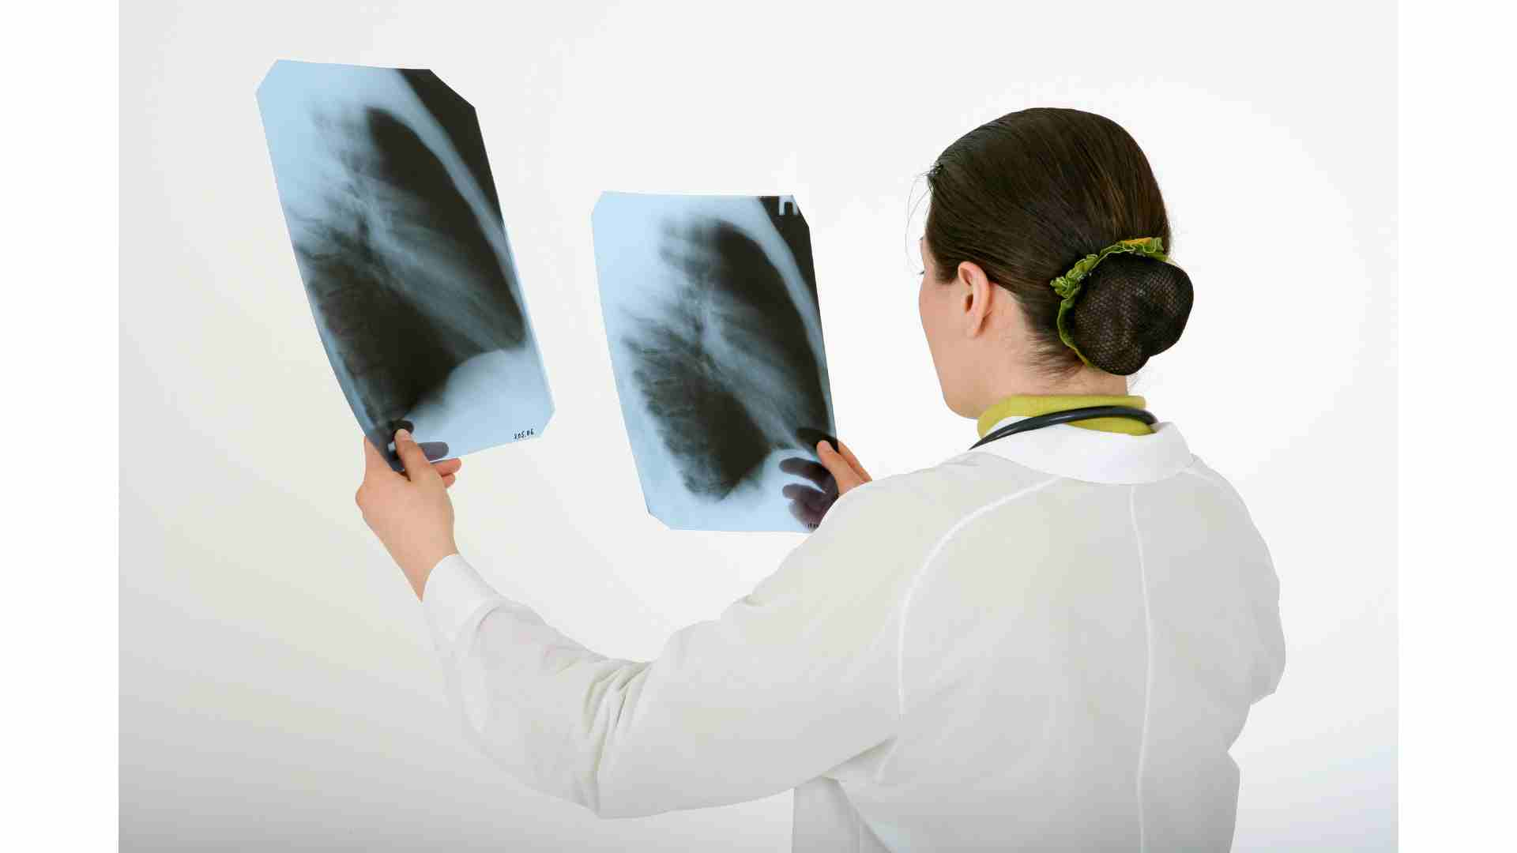
Research motivation
Pneumonia diagnosis is a time-consuming process that involves highly skilled professionals to analyze a chest radiograph or chest X-ray (CXR) and confirm the diagnosis with clinical history, vital signs, and laboratory tests.

Slide 4
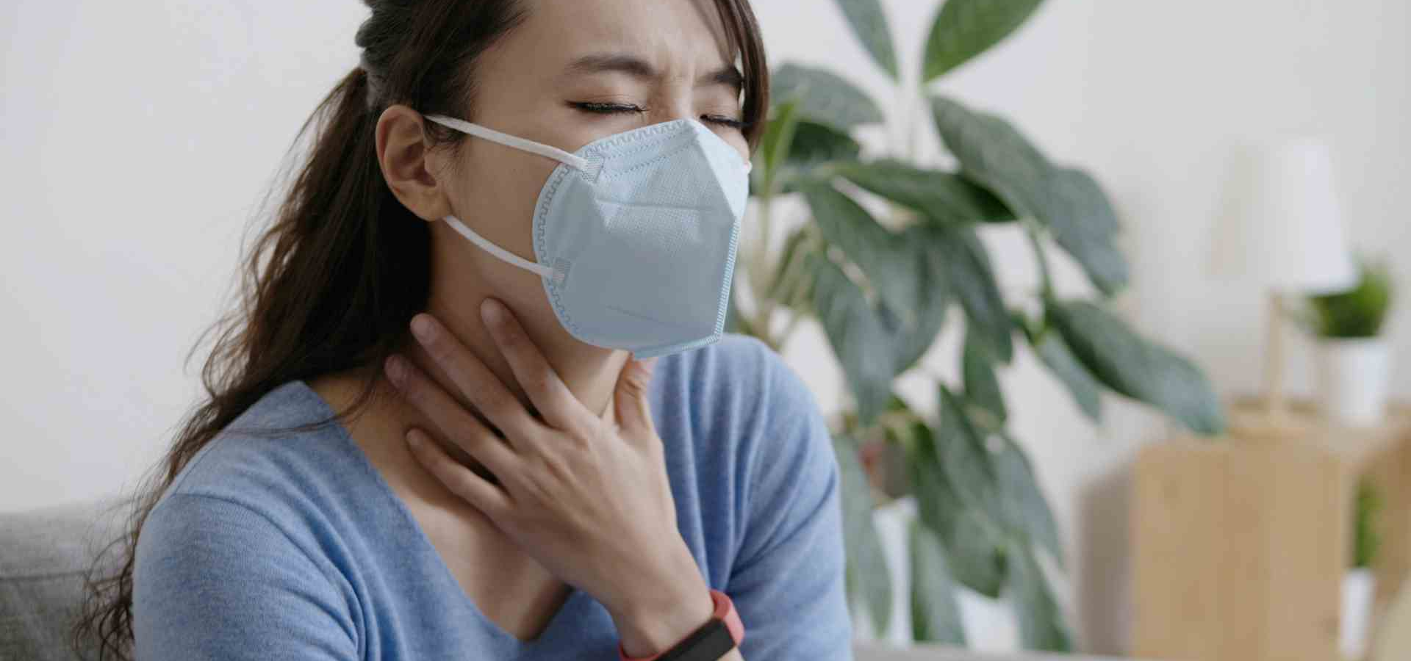
Research motivation - II
Pneumonia detection methods like Blood tests take longer time to give out results. Whereas methods like Sputum test is comparatively inaccurate and lastly, methods like CT Scan are very expensive for a common man. These factors inspired us to consider this project where a patient can get a rough idea about his health, thus decreasing costs for common man and number of tests required.
Blood Tests
Time Consuming
Sputum Tests
Inaccurate
CT Scans
Expensive

Slide 5
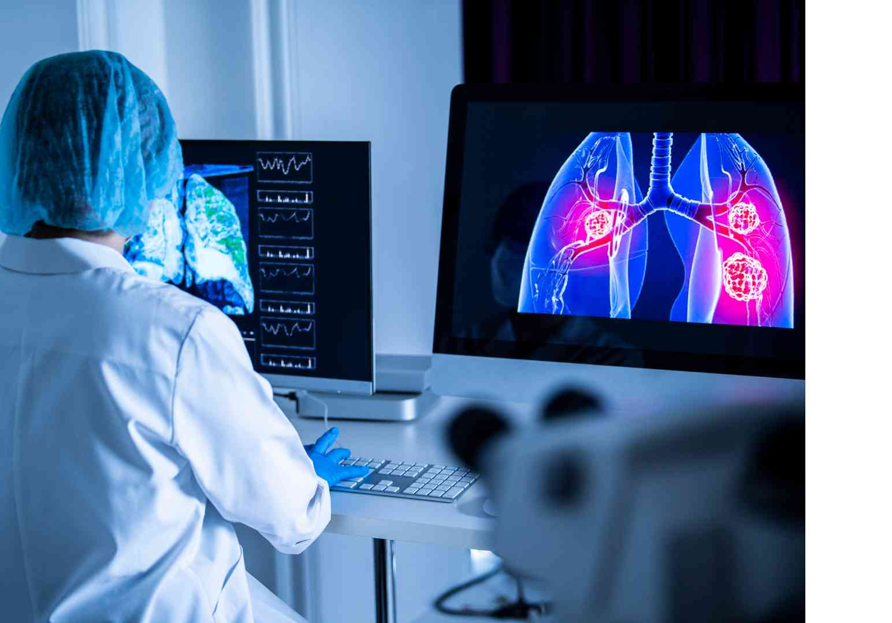
Objective
For application to CXR, deep-learning models can achieve detection performance close to that of radiologists.
We are building a Computer Vision model using Convolution Neural Networks that can detect bounding boxes around the region where the pneumonia related symptoms appear in CXR (Chest X-Ray).

Slide 6
Methodology - Overview
The study started with the literature survey and analysis of all the available data.
The inferences gathered from data and survey was used to create a basic CNN model.
From the basic CNN model, the study moved to the transfer learning models. The transfer learning model layers were not trained instead the pre-trained weights from ImageNet were only used.
We used InceptionNetv3 on 10000 stratified samples with input images downsized to 224 X 244.
Next, we moved to algorithms like U-Net and M-RCNN.
The entire project was aimed at getting a better understanding rather than achieve some kind of SOTA - given the resources and knowledge base we had.

Slide 7
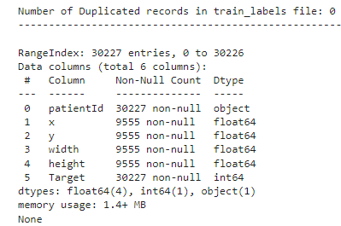
Exploratory Data Analysis
The dataset of Pneumonia containing CXR images of the patients has following fields :-
patientId - A patientId. Each patientId corresponds to a unique image.
x - the upper-left x coordinate of the bounding box.
y - the upper-left y coordinate of the bounding box.
width - the width of the bounding box.
height - the height of the bounding box.
Target - the binary Target, indicating whether this sample has evidence of pneumonia

Slide 8
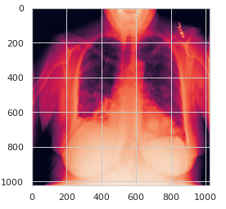
DICOM Image Format
A DICOM image file is an outcome of the Digital Imaging and Communications in Medicine standard.
A lot of information from the dicom has been removed. For example, we don't have the patient's name which is the same as their id. Also, there is no physician name and study id, nor is there the DOB of the patient.
There are 1024 rows and columns in the image- which should be the standard size of all the images. It is monochrome i.e. grayscale.
Every image takes up 8 bit of data. We convert them into 3-channel images before processing.

Slide 9
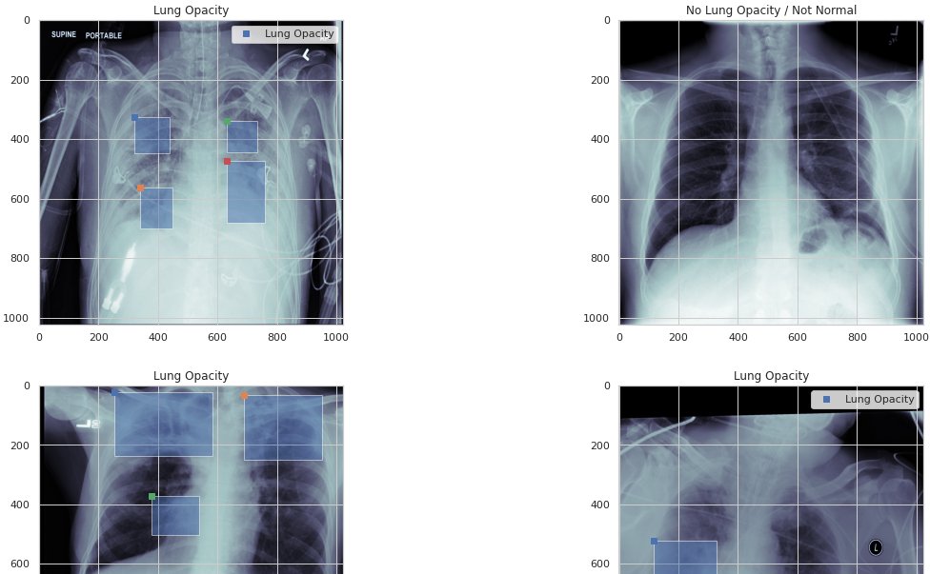
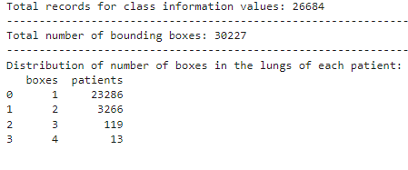
Bounding Box
The Summary of Bounding Boxes information on the images :-

Slide 10
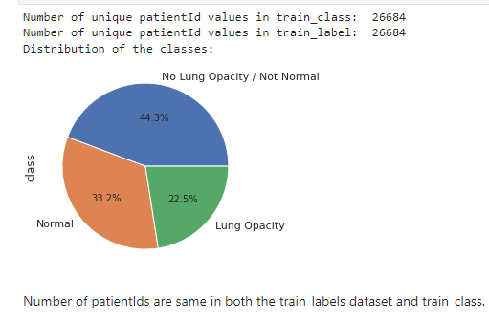
Data Distribution
The Representation of Class column via Pie Chart-
'Normal' indicates that the lung x-ray is normal, and so is the lung.
'Lung Opacity' confirms that the the lung has opacity and is indicative of pneumonia.
'No Lung Opacity / Not Normal' indicates that while pneumonia was determined not to be present, there was nonetheless some type of abnormality on the image and oftentimes this finding may mimic the appearance of true pneumonia.

Slide 11
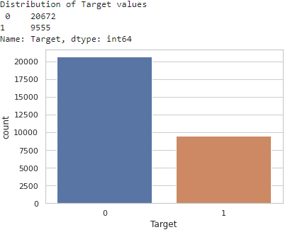
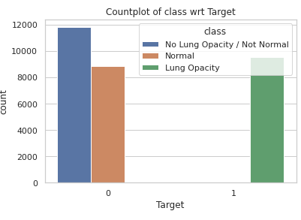
Target column Count Plots

Slide 12
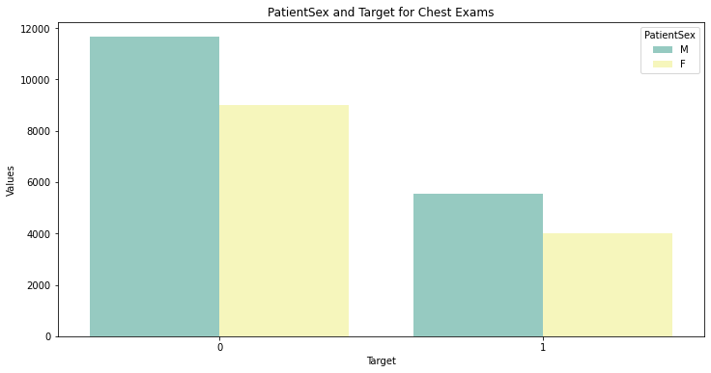
Gender Wise Count Plot for target column

Slide 13
METHODOLOGY – Base cnn model
For the base model, a CNN architecture was used to perform the multi-class classification of X-rays.
The base model architecture had 4 Convolutional layers along with MaxPooling (2 by 2) and dropout layers. The first two convolutional layers had 32 and 64 filters with size (3,3).
The activation function used for each convolutional layer was Relu.
The final output layer had 1 neuron for binary classification with activation function Sigmoid.

Slide 14
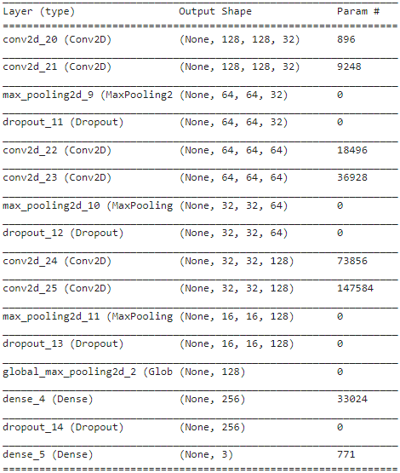
Model Building- Basic CNN without using Transfer Learning

Slide 15
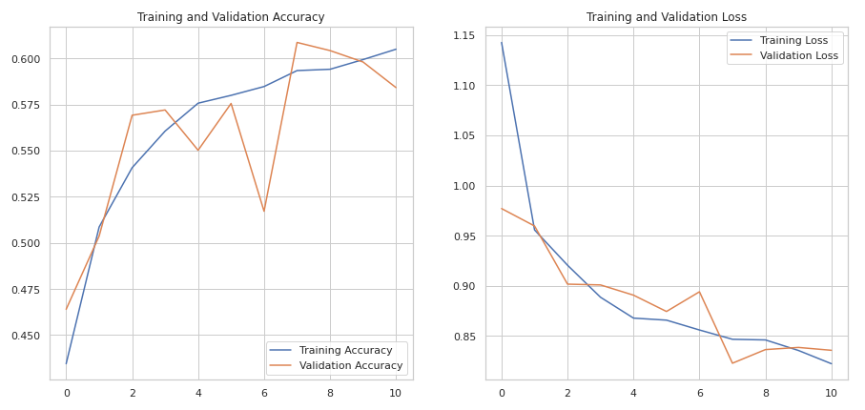
Result of Basic CNN-
Training accuracy is around 60 percent whereas validation accuracy is round 58 percent. We have avoided overfitting, but it seems to be clear that a normal CNN will not help us.
Test accuracy is also 61 percent is. At least our model is consistent.

Slide 16
CNN USING TRANSFER LEARNING
Transfer learning is a machine learning method where a model developed for a task is reused as the starting point for a model on a second task.
It is a popular approach in deep learning where pre-trained models are used as the starting point on computer vision and natural language processing tasks given the vast compute and time resources required to develop neural network models on these problems and from the huge jumps in skill that they provide on related problems.
In transfer learning, we first train a base network on a base dataset and task, and then we repurpose the learned features, or transfer them, to a second target network to be trained on a target dataset and task. This process will tend to work if the features are general, meaning suitable to both base and target tasks, instead of specific to the base task..

Slide 17
INCEPTION v3 - NET features
The inception V1 model uses the idea of using multiple filters of different sizes on the same level
Inception models instead of having deep layers, we have parallel layers thus making our model wider rather than making it deeper.
Efficient Grid Size Reduction
Spatial Factorization into Asymmetric Convolutions

Slide 18
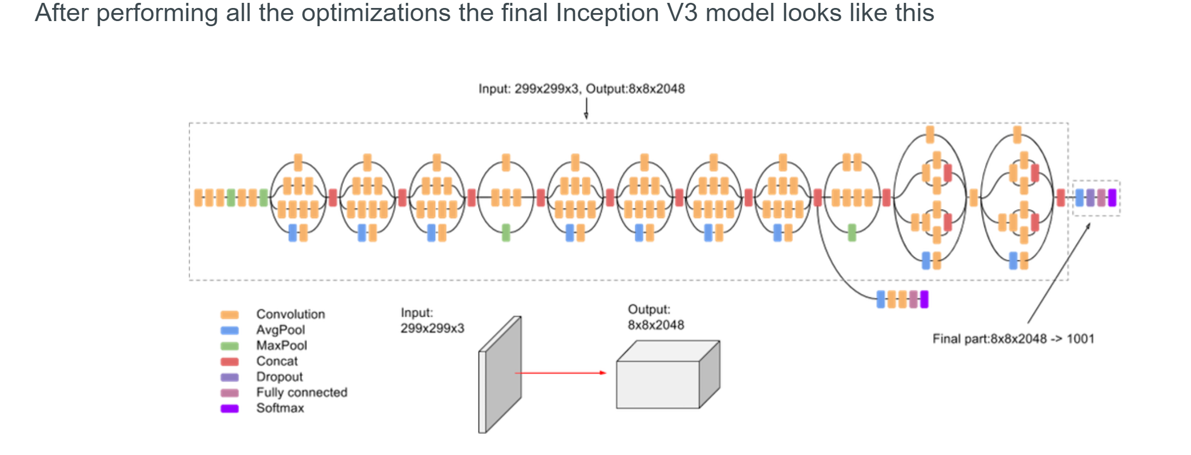
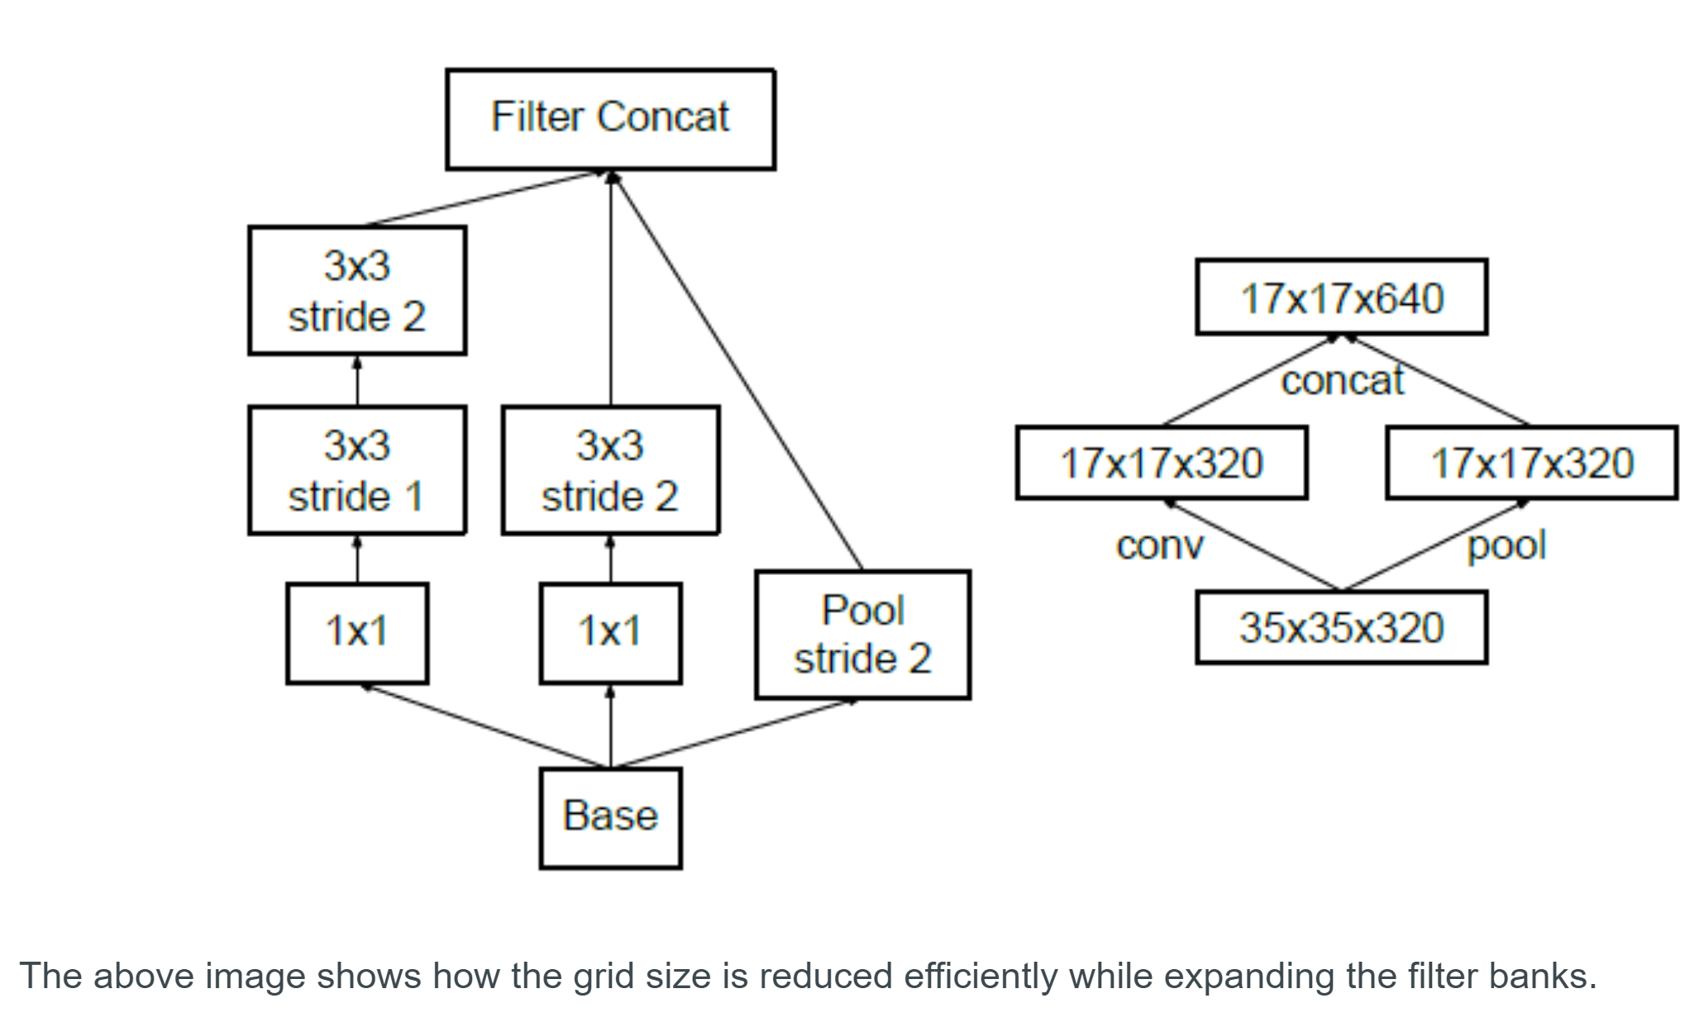
Inception v3 Model architecture

Slide 19
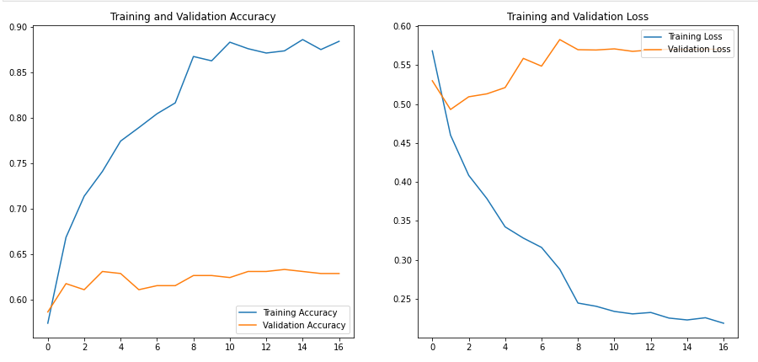
TRANSFER LEARNING WITH Inception V3- Results

Slide 20
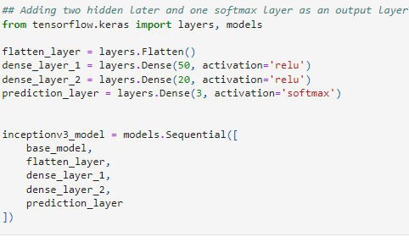
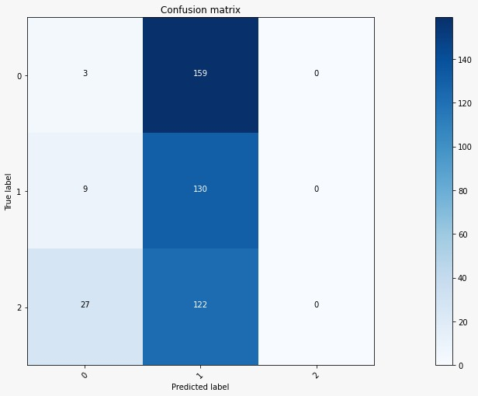

Model 2 – TRANSFER LEARNING WITH Inceptionv3
Test loss: 0.52
Test accuracy: 0.59
The scores are very low and the model is not useful.

Slide 21
Model 3 - UNET
Concatenation: The U-Net combines the location information from the downsampling path with the contextual information in the upsampling path to finally obtain a general information combining localisation and context, which is necessary to predict a good segmentation map.
Less training data: Augmentation. A random elastic deformation. The resulting image looks almost exactly like the original image and has been correctly classified with deformations as well.
Touching objects: Touching objects in the same class need to be correctly separated. Background image pixels are inserted between all touching objects and individual loss weight is assigned to every pixel. Using weighted loss enables a strong penalization for separating background labels between touching cells.
No dense layer, so images of different sizes can be used as input (since the only parameters to learn on convolution layers are the kernel, and the size of the kernel is independent from input image size).
Read more: https://medium.com/@aaweg-i/computer-vision-u-net-6d21e08b09d7

Slide 22
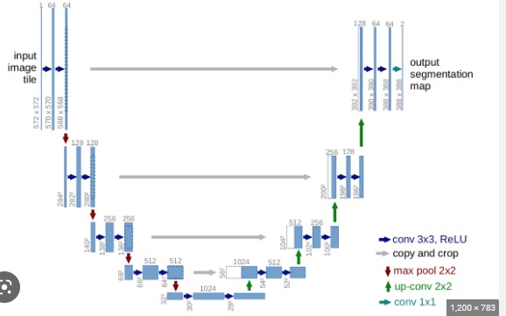
Model 3 - UNET

Slide 23
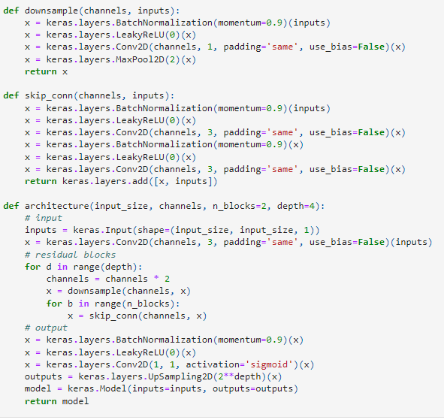
Architecture Network - used Unet

Slide 24
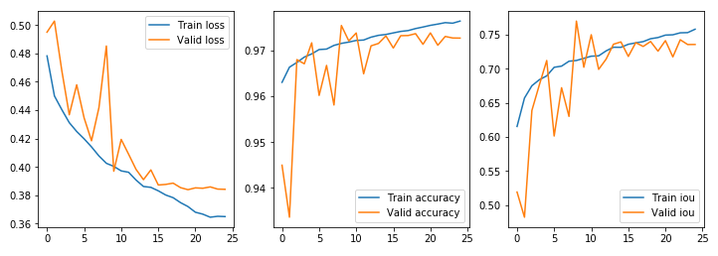
Evolution of loss, accuracy and IoU

Slide 25
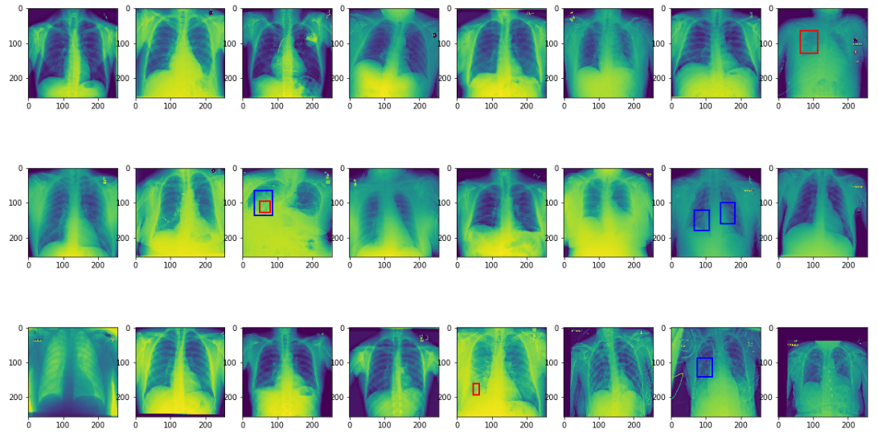
Plotting predictions in one batch- Unet Model

Slide 26
Summary
Thus we took up a challenging task which is still being researched upon by radiologist and deep learning engineers worldwide and by going a little deeper into the literature and various models available online, we improved upon existing knowledge,
We are keen to go deep into image segmentation and understand how Mask R-CNN improves upon U-Net and Faster R-CNN.

Slide 27

Thank you
Questions Please

